Slide 1
Verifying MIPS Assembly Programs via Computational Tree Logic Model Checking
Darko Poposki, Risto Petroski, Dimitar Stojkovski, Guido Sciavicco

Slide 2
Introduction
Formal verification of low level software;
Low level software is complex;
Software model checking;
Temporal logic:
Linear
Branching (Computational Tree Logic (CTL))
Application of this methodology to the verification of MIPS Assembly programs.

Slide 3
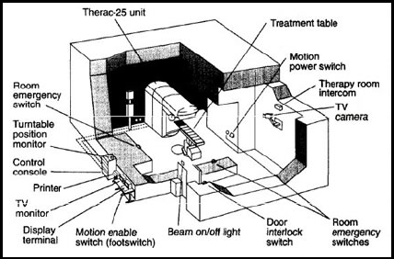
Importance of Model Checking (1)
Therac-25 radiation machine for treatment of cancer patients (1985-87).

Slide 4
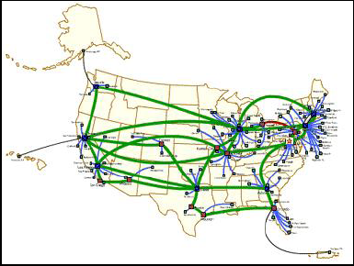
Importance of Model Checking (2)
AT&T Telephone network problem in New York (1990).

Slide 5
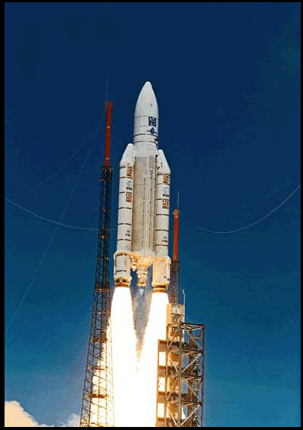

Importance of Model Checking (3)
Ariane 5 Crash (1996).

Slide 6
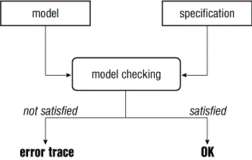
What is Model Checking?
Model Checking is an automatic technique for verifying finite-state systems.

Slide 7
MIPS Architecture and Assembly (1)
MIPS has 32 integer registers;
Data must be in registers to perform arithmetic;
31 of these are general-purpose registers that can be used in any of the instructions.

Slide 8
MIPS Architecture and Assembly (2)
Limit to the following types of operations:
Arithmetical operations
Label definitions
Unconditioned branches
Conditioned branches
Immediate operations
Syscalls
Exclude the following:
Defining functions
Using the stack

Slide 9
Example of Assembly Program
.text # Beginning of the instructions
main: # Starting label
li $t0, 1 # Load value 1 in register $t0
li $t1, 0 # Load value 0 in register $t1
beg_cycle: # Label for starting a cycle
bgt $t0, 10, end_cycle # $t0 > 10, go to label
add $t1, $t1, $t0 # $t1 = $t1 + $t0
add $t0, $t0, 1 # $t0 = $t0 + 1
b beg_cycle # Branch to beg_cycle
end_cycle: # Ending label

Slide 10
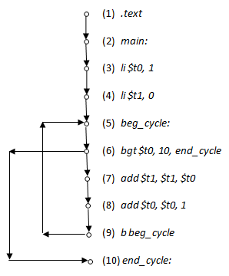
Temporal Model of the Program

Slide 11
Temporal Logic CTL (1)
Branch quantifiers:
A (for all futures)
E (for some future)
Future operators:
G (always)
F (sometime)
X (nexttime)
U (until)

Slide 12
Temporal Logic CTL (2)
Checking over a MIPS program;
Consider the following property: it is never the case that a register is used if it has not been initialized before;
The formula corresponding to the above requirement is:
ᄀ(EU(ᄀi, a))

Slide 13
The Verifier
Our system is designed into three connected parts:
MIPS Program reading and model building;
Safety requirement reading and tree-creation;
Checking.

Slide 14
Phases (1)
Phase 1.
MIPS programs written in text files;
Two boolean arrays: ValueSet and Accessed;
Function sets the logical sequence of operations.
Phase 2.
Formulas are supposed to be written in prenex - left first order;
0ᄀEUᄀia
A pointer is returned to the binary tree that represents the formula in question.

Slide 15
Phases (2)
Phase 3.
Checking for each level, for each (sub)formula at that level, and for each node of the structure;
Answer positive – creating link to the corresponding node;
At the end: if a pointer from the root of the structure to the root of the formula tree is present – formula is true in the current model.

Slide 16
Example of Verification
ᄀ(EU(ᄀi, a))

Slide 17
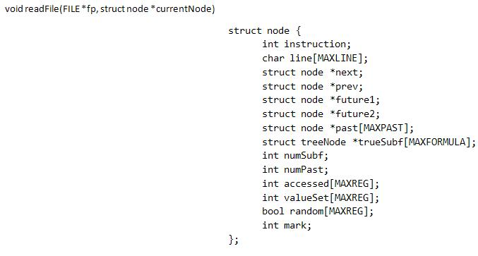
Program Model creation

Slide 18
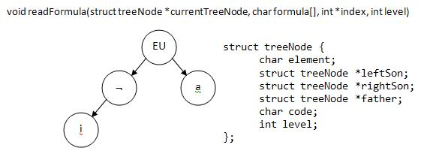
Formula Tree creation

Slide 20
Conclusion
Formal verification of low level software is important;
Model checking CTL formulas to a specific problem;
This is the problem of formally checking MIPS Assembly simple programs;
Different programs;
Different kinds of temporal formulas;
This experiment partially covers the gap in formal verification of software for low level languages.

Slide 21
References (1)
[1] S. Chaki. Sat-based software certification. In Proceedings of the 12th Conference on Tools and Algorithms for the Construction and Analysis of Systems (TACAS2006), pages 151-166, 2006.
[2] S. Chaki and J. Ivers. Software model checking without source code. ISSE, 6(3):233-242, 2010.
[3] E. Clarke, A. Groce, S. Jha, and H. Veith. Modular verification of software components in C. In Proceedings of ICSE 2003, pages 385-395, 2003.
[4] E. Clarke, D. Kroening, and F. Lerda. A tool for checking ANSI-C programs. In Proceedings of the 10th Conference on Tools and Algorithms for the Construction and Analysis of Systems (TACAS2004), pages 168-176, 2004.

Slide 22
References (2)
[5] E. Allen Emerson. Temporal and modal logic. In HANDBOOK OF THEORETICAL COMPUTER SCIENCE, pages 995-1072. Elsevier, 1995.
[6] G. Holzmann. The SPIN Model Checker: Primer and Reference Manual. Addison-Wesley, 2003.
[7] Z. Manna and A. Pnueli. The Temporal Logic of Reactive and Concurrent Systems: Specification. Springer, 1992.
[8] N. Marti. Formal Verification of Low-Level Software. PhD thesis, 2008.
[9] A. Pnueli. Applications of temporal logic to the specification and verification of reactive systems: A survey of current trends. In Current Trends in Concurrency, pages 510-584. 1986.

